Slide 1

Vagrant Virtualbox instructions for PHYS3003 and PHY2100
Presenter Name

Slide 2




Procedures
Install Virtualbox
Install Vagrant
Install Git for windows
Install mobaXterm for windows
Starting / Accessing Virtual Machines
Shutdown Virtual Machines

Slide 3



Introduction to Virtualization
Virtualization allows you to run a “virtual machine” or VM with a different operating system in this case linux on your laptop (Macbooks and Windows.
NOTE IF YOU HAVE A NEW MACBOOK WITH A M1 PROCESSOR. Contact the lecturer for another option.

Slide 4

Open-Source Software Requirements For Windows laptops
We will introduce you to a few open-source tools.
If you are using a Windows OS laptop you will need to install Virtualbox, Vagrant, Git, and MobaXterm. Here are links to the software:
VirtualBox hint: Select Windows hosts
Vagrant hint: Select 64-bit
Git for Windows
mobaXterm hint: Select the installer edition!

Slide 5
Open-Source Software Requirements For Macbooks
We will introduce you to a few open-source tools.
If you are using a Macbook you will need to install Virtualbox, Vagrant, and XQuartz. Here are links to the software:
VirtualBox hint: Select OS X hosts
Vagrant hint: Select 64-bit
XQuartz

Slide 6
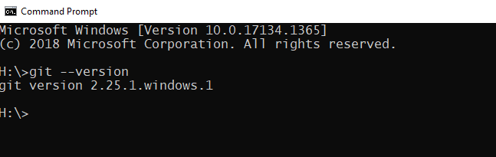
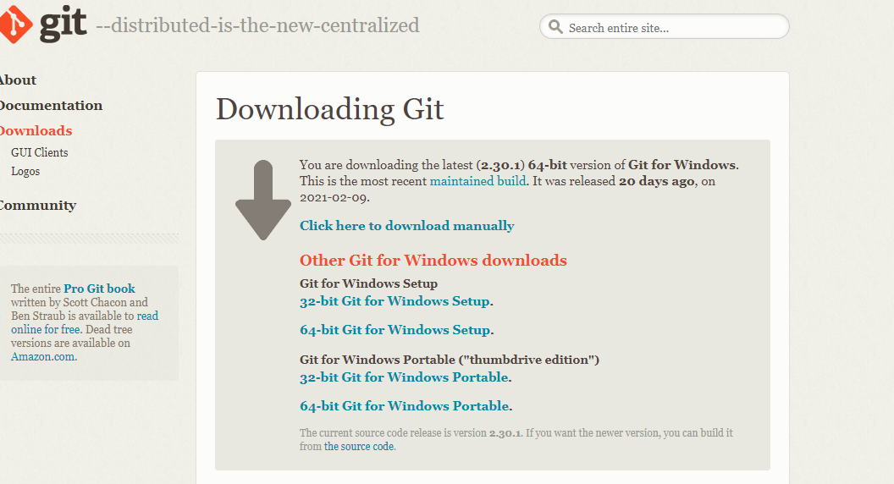
Test GIT on Windows To check if Git is install on your computer us the command > git --version
If it is does return something similar to the example shown. Here is a link to the current version (2.35.1.2) of the software. It does not need to be the exact same version as shown!
https://gitforwindows.org/
Recommend the 64-bit Git for Windows Setup

Slide 7
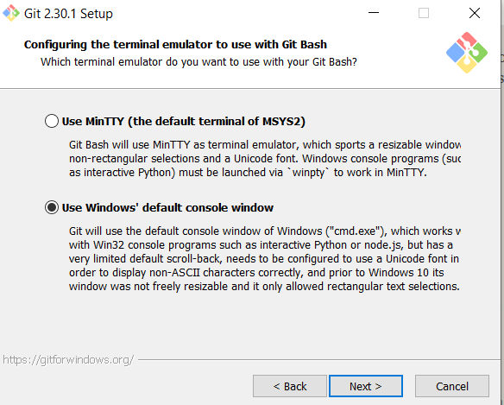
Git installation issues with Window
CAUTION!!
In the Git Setup / installation step:
Configuring the terminal emulator to use with Git Bash
Select the “Use Windows’ default console window”
Not the default which is set to “Use MinTTY”

Slide 8

Command Line Prompts
Terminals have a command line that use a Prompt symbol. It can be represented by many different symbols and is highly customized feature. In the notes it is represent by the GREATER THAN – “>” symbol. You DO NOT need to include it when entering a command.

Slide 9
Setting up your Virtual Machine
Once Vagrant VirtualBox and Git are installed and working, you can then begin setting
up a Virtual Machine or VM that will run locally on your laptop.
Step 1 – Create the directory structure for this project.
For Windows using the Command Prompt terminal the command is:
> mkdir Courses
For MacOS and linux the command is:
> mkdir Courses
To make the courses directory the working directory, use the command “cd”
it is the same for Windows and MacOS
> cd Courses

Slide 10
Setting up your Virtual Machine: Clone the github repository
Step 2: clone the vagrant file repository from github
For Windows and Macs this step the command is identical.
> git clone https://github.com/chrisbuwahpc/icrar_deploy.git
To verify that the command worked you can inspect the current directory for the new folder.
On Windows:
dir --- this shows all the files and sub-directories in the current folder
On Macbooks/Linux
ls -- LIST so that is lower case L
You should see a directory icrar_deploy
Once Vagrant VirtualBox and Git are installed and working, you can then begin setting
up a Virtual Machine or VM that will run locally on your laptop.

Slide 11
Setting up your Virtual Machine: Clone the github repository
Step 2: clone the vagrant file repository from github
For Windows and Macs this step the command is identical.
> git clone https://github.com/chrisbuwahpc/icrar_stars.git
To verify that the command worked you can inspect the current directory for the new folder.
On Windows:
dir --- this shows all the files and sub-directories in the current folder
On Macbooks/Linux
ls -- LIST so that is lower case L
You should see a directory named icrar_stars
Once Vagrant VirtualBox and Git are installed and working, you can then begin setting
up a Virtual Machine or VM that will run locally on your laptop.

Slide 12

Setting up your Virtual Machine:
Configuring your virtual environment
Step 3: Change director into the course/icrar_stars directory
> cd icrar_stars
You can check that it worked using the “ls” or “dir” command and you should see a file named
“Vagrantfile” it contains the instructions to setup the Virtual Machine. You don’t need to make
changes to it.
Step 3a: Creating the VM
To create the VM, you must be in same directory as Vagrantfile which is the icrar_stars directory.
To create the VM the Vagrant command is
vagrant up
Coffee/Tea Break:
This will take some time as it automatically downloading and configuring the customised base Ubuntu OS image that is used for your VM. It is dependent on your internet connection and laptop.

Slide 13

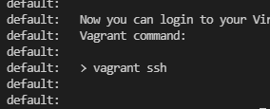
VM SUCCESS!!
Coffee/Tea Break:
This will take some time (UP to 30 MINUTES!) as it automatically downloading and configuring the base Ubuntu OS image that is used for your VM. It is dependent on your internet connection and laptop.
When the “vagrant up” command finishes you should see the follow message!
You are now ready to login to your VM!

Slide 14
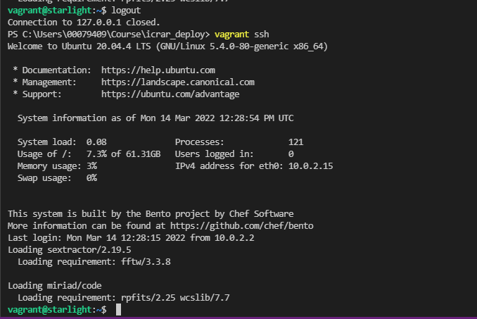
Accessing your Virtual Machine
Step 4: Secure Shell (SSH) is used to login to your VM. This process of accessing you VM has been greatly simplified with Vagrant. The command is:
> vagrant ssh
Notice that the prompt changes to
vagrant@starlight:~$
This is means you are on the VM!

Slide 15
You can now run Swarp and SExtractor commands in the terminal.

Slide 16
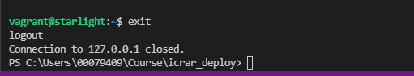

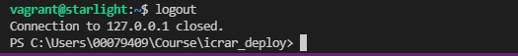
Exiting your Virtual Machine CLEANLY! there are multiple ways to exit the VM cleanly
Exit or Logout
CTRL-d
Or

Slide 17
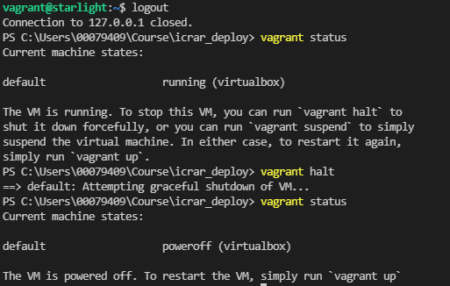


HOW TO POWEROFF your VM with VAGRANT It is important to Poweroff the VIRTUAL machine gracefully so IT restarts properly.
Vagrant Status to show the VM state.
Running - machine state
SHUTDOWN the VM
Vagrant Status to show the VM state.
POWEROFF – machine STATE

Slide 18
Content
Subtitle
Subtitle
Add text, images, art, and videos.
Add transitions, animations, and motion.
Save to OneDrive, to get to your presentations from your computer, tablet, or phone.
Open the Design Ideas pane for instant slide makeovers.
When we have design ideas, we’ll show them to you right there.

Slide 19
Basic VM summary
Step 1 - Change to the project directory
> cd courses
> cd icrar_deploy
Step 2 - launch the Virtual machine
> vagrant up
Step 3 - use ssh to login to the virtual machine (VM)
> vagrant ssh
exit
Step 5 – shutdown the virtual machine (VM)
vagrant halt
Step 4 – exit or logout of the Virtual Machine
> exit
Step 5 – shutdown the virtual machine (VM)
> vagrant halt

Slide 20
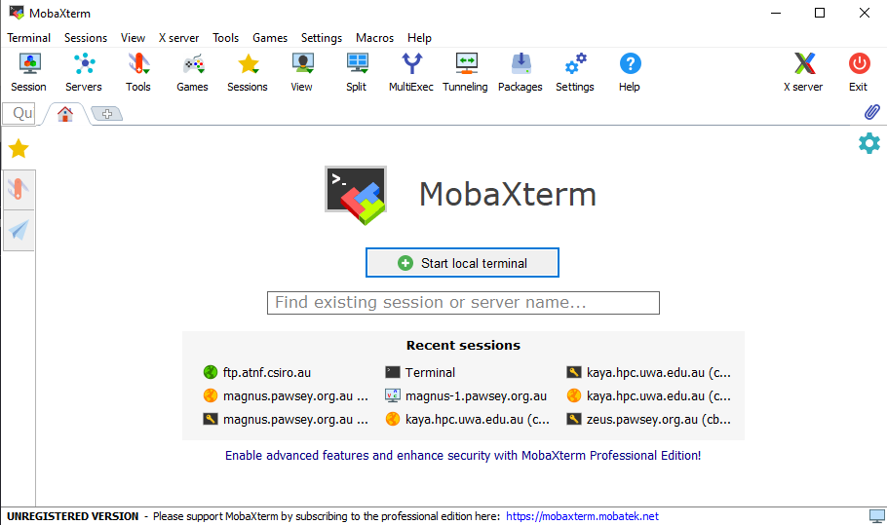
To use the GUI based applications if you on a Windows laptop you need to install MobaXterm

Slide 21
Start a local terminal

Slide 22
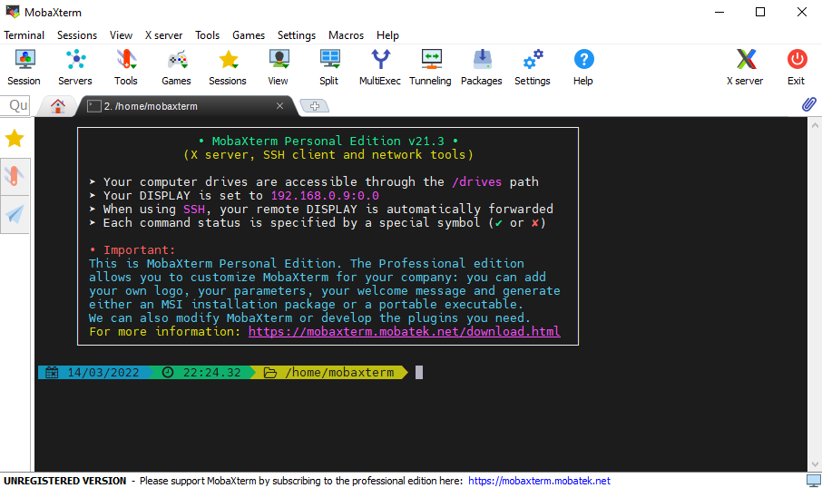
MobaXterm
local terminal
MobaXterm defines it’s own home directory it
Is /home/mobaxterm. To access you icrar_deploy directory
on your host system you will need to cd to it.
If you have followed the configuration for setting up your VM the full path is
/mnt/c/Users/”your username”/Courses/icrar_stars
so change directory using
>cd /mnt/c/Users/”your username”/Courses/icrar_stars
IF YOU ARE NOT IN THE “icrar_stars” directory the GUIs don’t work correctly!!!

Slide 23
To run the GUI applications Topcat and ds9 from the
mobaXterm local terminal
Topcat
ssh -X -p 2222 vagrant@127.0.0.1 /home/vagrant/bin/topcat
ds9
ssh -X -p 2222 vagrant@127.0.0.1 /icrar/ubuntu20.04/apps/gcc/9.4.0/ds9/8.3/bin/ds9

